Slide 1
Statistics for linguists
2023-11-08
Adam J.R. Tallman

Slide 2
Exercises
Let’s read a dataframe in https://osf.io/ptq7u
https://osf.io/sj7nu
And the vowels2 dataframe on moodle

Slide 3
Concepts
Types of variables
Operationalization
Scatter plots
Histograms
Boxplots
Density distributions

Slide 4
Variable types
Continuous: varies along a quantifiable continuous (non-discrete) parameter
Categorical: unordered (discrete) categories
Binary: there are just two (discrete) options
Ordinal: there are (discrete) categories that are ordered

Slide 5
Variable types
Remember from last class
Concepts like ‘central tendency’ and ‘spread’ are the baseline of what is important for statistical analysis.
The concepts of central tendency and spread are differ depending on the variable

Slide 6
Continuous variable
A variable that varies along a continuous parameter
In linguistics:
Vowel duration, Response time, Test scores, Pitch, Frequency ...
Outside of linguistics:
weight, temperature, distance, speed, income, time, etc.

Slide 7
Categorical variable
Variable which takes on values which are discrete (qualitatively distinct)
Outside of linguistics
social class, employment, school, color, voting, gender?,
Inside of linguistics
phoneme, morpheme, genre, speaker, language, family, gender?

Slide 8
Operationalization
There is a difference between a concept being continuous in theory and in our data model
Something could be continuous in principle, but not operationalized in this fashion in our dataset.
Age – 22 years, 3 months, 4 days or ‘young’
Gender – ‘male’ or ?

Slide 9
Binary variable
When there are only two options we refer to a variable as binary:
Outside linguistics
A yes/no response in an experiment, voting in the U.S.
Inside Linguistics
Voiced vs. voiceless stops, Word choice in an experiment, choice between two variant pronunciations, gender?

Slide 10
Ordinal variable
There is a natural and obvious order to the variables even when the values are discretely distinct
The variables can be ranked on a scale, but they are not continuous
E.g. grade 1, grade 2 etc.; BA, MA, PhD; from careful vs. less careful speech registers

Slide 11
Scatter plot
When you have two continuous variables, you can display their relationship with a scatter plot.
The horizontal dimension is the x-axis
The vertical dimension is the y-axis

Slide 12
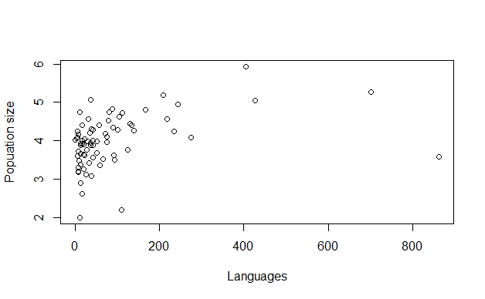
Population size vs. number of languages

Slide 13
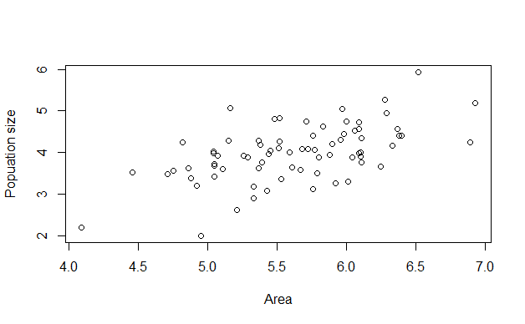
Population size vs. Area

Slide 14
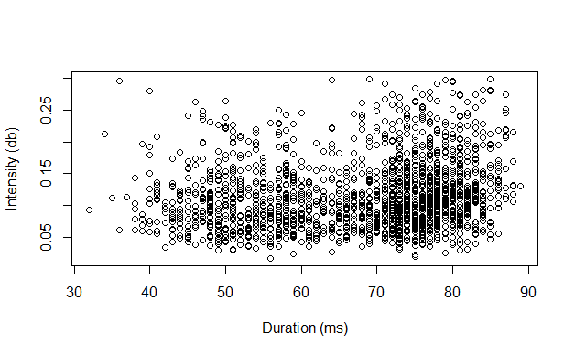
Vowel duration vs. intensity

Slide 15
Models
You use linear models with continuous variables – which can also be displayed over a scatter plot.
The basic function in R is lm()
y = a + x*b + e
y = x*b (y is the same as x but multiplied by b)
y = a+x (y is the same as x but with a added)
y = x + e (y is the same as x but with some probabilistically determined error)

Slide 16
Histograms
Histograms are for relative frequencies – you can use them if you are looking at the distribution of a single continuous variable
Categorical variables are most stereotypically depicted with histograms displaying the relative frequency of each category
x-axis gives you your category
y-axis gives you the frequency

Slide 17
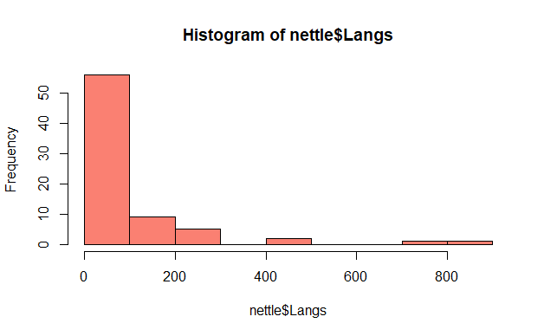
Number of Languages

Slide 18
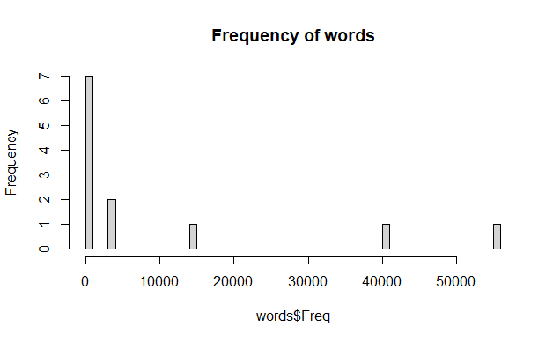
Frequency of words

Slide 19
Boxplots
Comparing a continuous parameter and a categorical one.
y-axis: the continunous variable
x-axis: the categorical variable

Slide 20
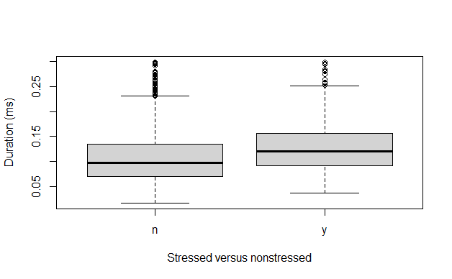
Duration by stress

Slide 21
Break for coding

Slide 22
Density distribution
Density distribution presents all the possible values and their relative probabilities.
There’s an important conceptual shift from frequencies to probabilities

Slide 23
Probability
What’s a probability?
Probabilities assign numbers to possibilities.
Bayesian
Degree of belief
Frequentist
Long run frequency over an infinite amount of trials

Slide 24
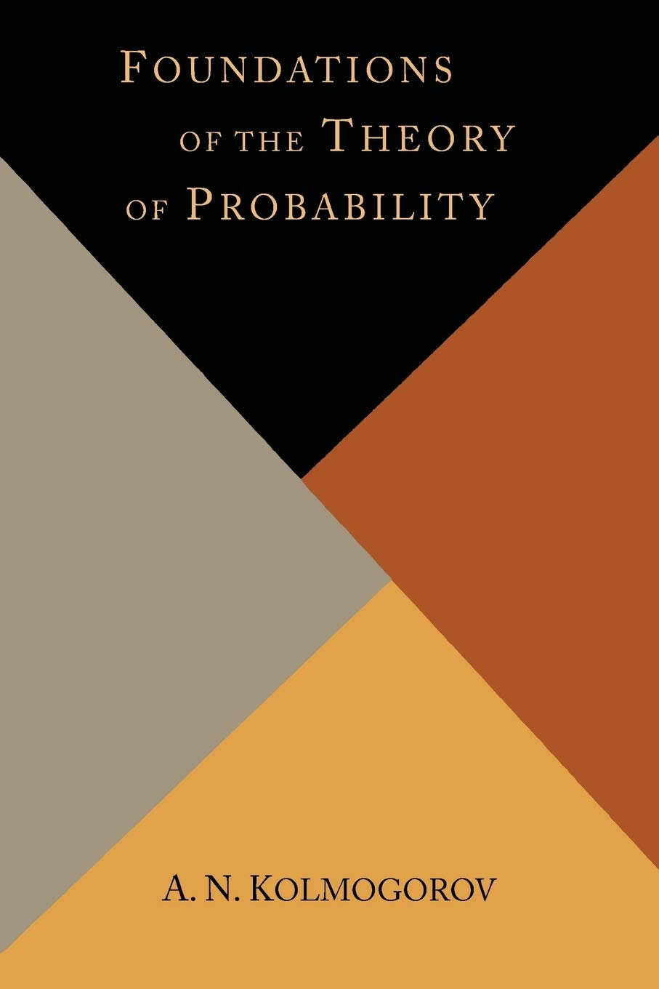
Probability
Axioms of probability
1. A probability value must be non-negative (i.e., zero or positive).
2. The sum of the probabilities across all events in the sample space must be 1
3. For any two mutually exclusive events, the probability that one or the other occurs is the sum of their individual probabilities.

Slide 25
Probability distributions
A probability distribution is a list of all possible outcomes and their corresponding probabilities.
What’s the probability distribution of a coin toss?

Slide 26
Probability distributions
“A probability distribution is a list of all possible outcomes and their corresponding probabilities.”
(Kruschke 2011: 30 Doing Bayesian Data Analysis)
What’s the probability distribution of a coin toss?
p and 1 – p
If its fair its just 0.5 and 0.5

Slide 27
Probability distributions
“A probability distribution is a list of all possible outcomes and their corresponding probabilities.”
(Kruschke 2011: 30 Doing Bayesian Data Analysis)
What’s the probability distribution for the number of calories you might consume in a day?
What’s the probability distribution for the duration of a vowel?
What’s the probability distribution for a word being used in a given syntactic construction?

Slide 28
Probability distributions
Probability mass: when we are talking about discrete outcomes.
Probability density: when we are talking about continuous outcomes.
There’s a conceptual difference here: its easy to talk about the probability of specific outcomes which are discrete … but this isn’t true when the values are on a continuum.

Slide 29
Probability distributions
What’s the probability that you will consume exactly 2000.00000…. calories?
Pretty much zero.
What’s the probability that a vowel will be exactly 80.00000…. milliseconds long
Pretty much zero.
Instead, we talk about intervals (e.g. probability of 2000 or higher, probability of vowel being between 70 and 90 milliseconds).

Slide 30
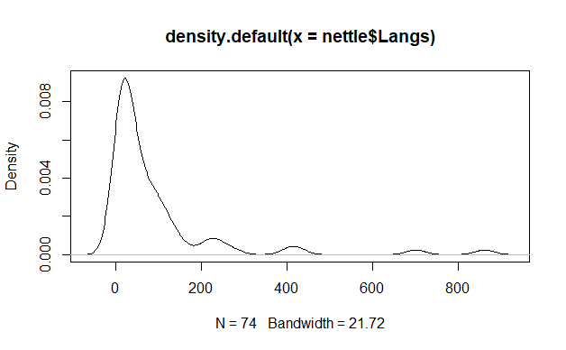
Probability (density) distribution of vowel population size

